Slide 1
Unit 12
MsPham
0936082789
Jobs
Lesson 2 – Period 2

Slide 2
Warm up

Slide 3
Let’s check!
PLAY
Notes:
Ms Huyền Phạm - 0936.082.789 – YOUTUBE: MsPham. Facebook: Dạy và học cùng công nghệ.

Slide 4
What does he work?
He works
_________________.
on the farm
Answer
Next

Slide 5
What does she work?
She works
_________________.
at the nursing house
Answer
Next

Slide 6
What does he work?
He works
_________________.
at the factory
Answer
Next

Slide 7
What does she work?
She works
_________________.
at the school
Answer
Next

Slide 8
What does she work?
She works
_________________.
at the library
Answer
Next

Slide 9
What does she work?
She works
_________________.
at the hospital
Answer
Next

Slide 10
Great job!
s
EXIT
Notes:
Ms Huyền Phạm - 0936.082.789 – YOUTUBE: MsPham. Facebook: Dạy và học cùng công nghệ.

Slide 11
Review
MsPham
0936082789

Slide 12
What does he/she do?
MsPham
0936082789
He’s/She’s _____.
at a
nursing home
at a school
at a factory
on a farm

Slide 13
Practice
MsPham
0936082789

Slide 14
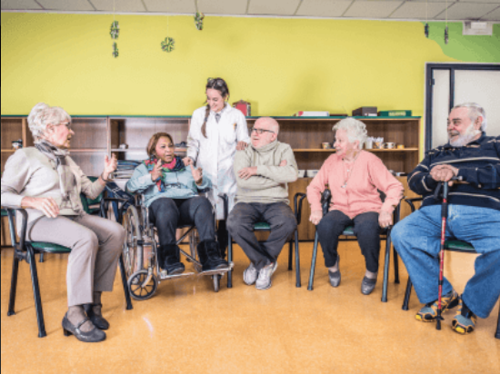
4
Listen and tick.
1
2
MsPham
0936082789
a
b
✓
a
b
✓

Slide 15
5
Look, complete and read.
1.
2.
MsPham
0936082789
A: What does your mother do?
B: She's a _______________.
A: Does she ____________ a nursing home?
B: No, she doesn't. She works at a hospital.
A: What does your brother do?
B: He’s _________________.
A: Where does he __________?
B: He works _______________.
nurse
a worker
work
work
at a factory

Slide 16
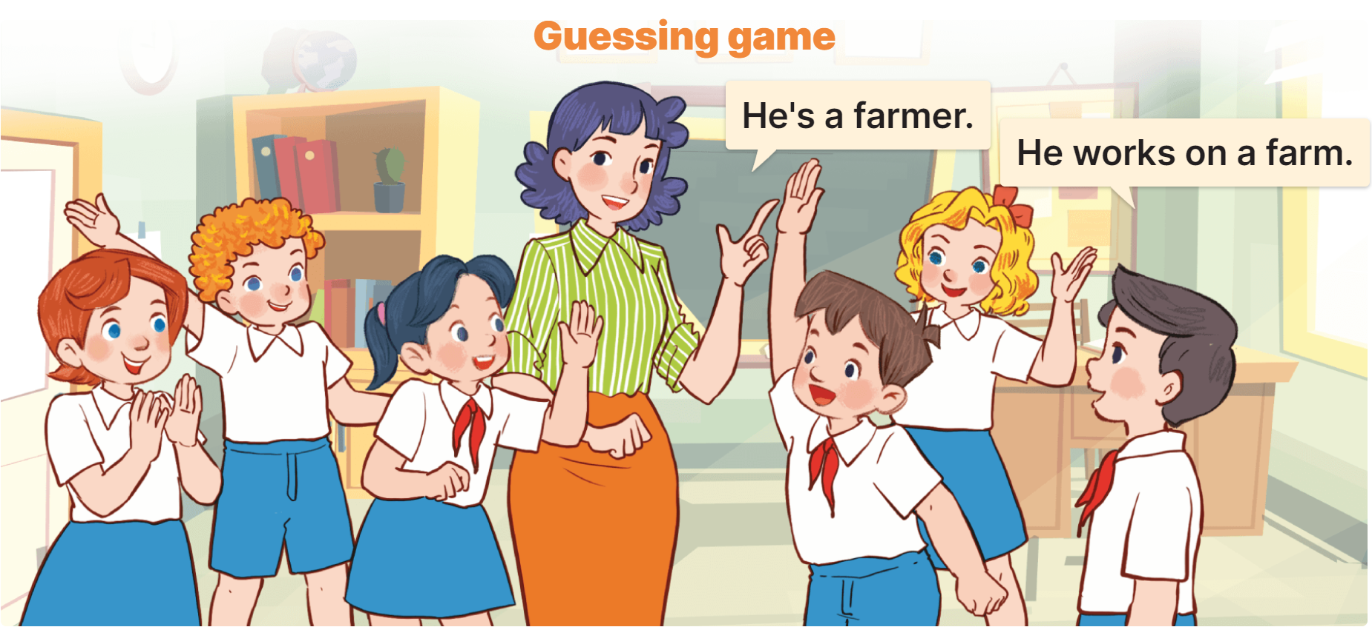
6
Let’s play.

Slide 17
Thank you!
MsPham
0936082789

